Slide 1
Sprint #4: Recap of Robotics
By Tennessee Tremain, Alexander DiDomenico and Wilmary Guzman

Slide 2

Challenges You Faced
A challenged we faced at first as a group was the lack of communication within the group, which backed up or work progress for sprint 1.
Sprint 2 took a longer time adjusting the block code and making sure that it ran thoroughly and smoothly.
Videos took a very long time to film (other than Sprint #3)

Slide 3

Roles of Each Team Member
Flowchart- Wilmary
Gantt Chart - Wilmary
SDD Code-Tennessee
Sensor Data- Alexander
Testing - all team member
Take Video - Wilmary
Algorithm - Tennessee

Slide 4

What Have You Learned About Software Engineering?
Several Individual Parts Make Up One Large Project
There Are Problems In Every Project Which You Would Never Expect
Software engineering also has an impact on our daily routines

Slide 5
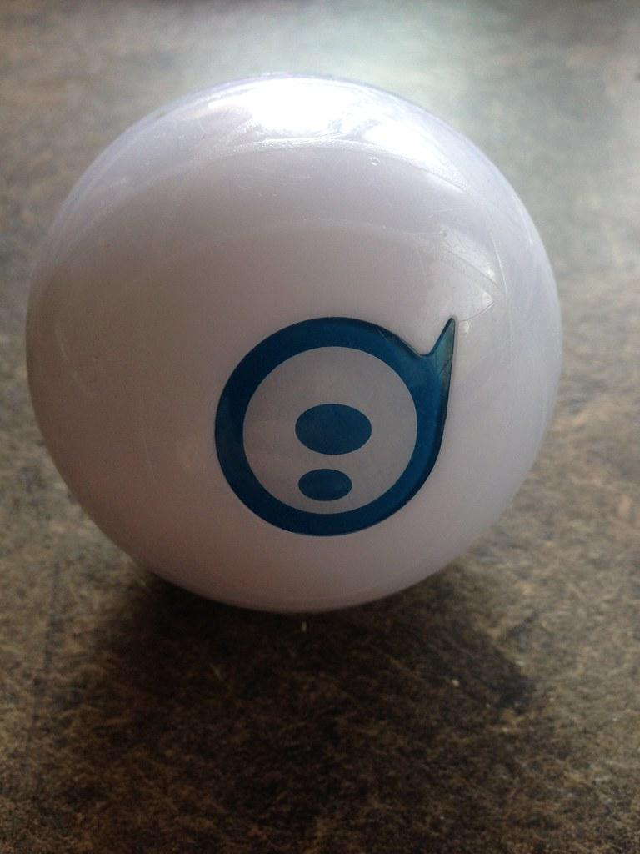
What Would You Do Differently?
Starting Planning Earlier
Splitting up Tests Into Individual Runs
Videoing Later (Before Individual Sections Were Not Perfect)

Slide 6
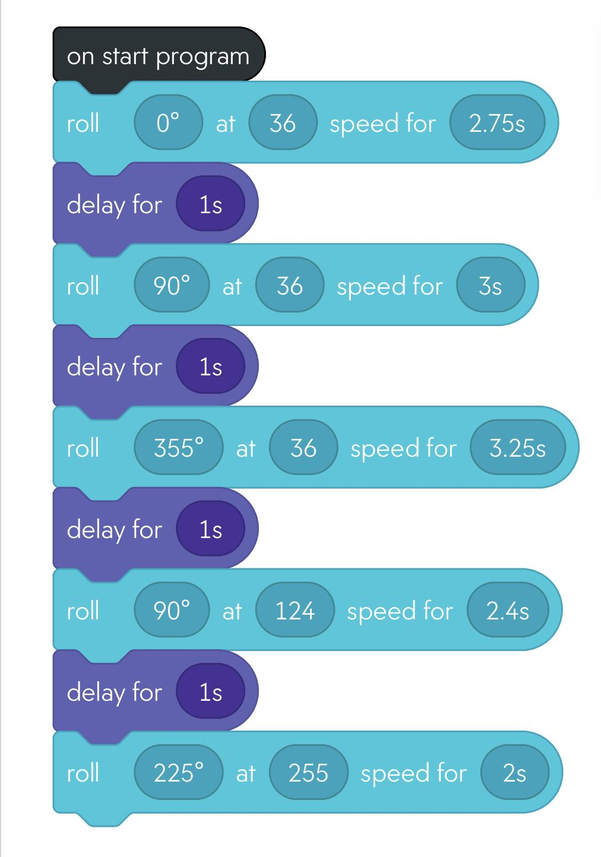
Block Code For Sprint 3 Agility

Slide 7
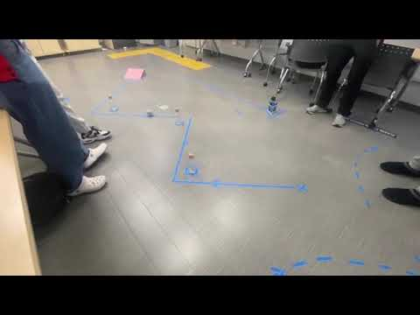
Video Of Your Robot Doing the Agility Sprint:

Slide 8

THANKS FOR WATCHING

